Slide 1
OPTICAL SENSORS AND ACTUATORS
A report in MECE 614

Slide 2
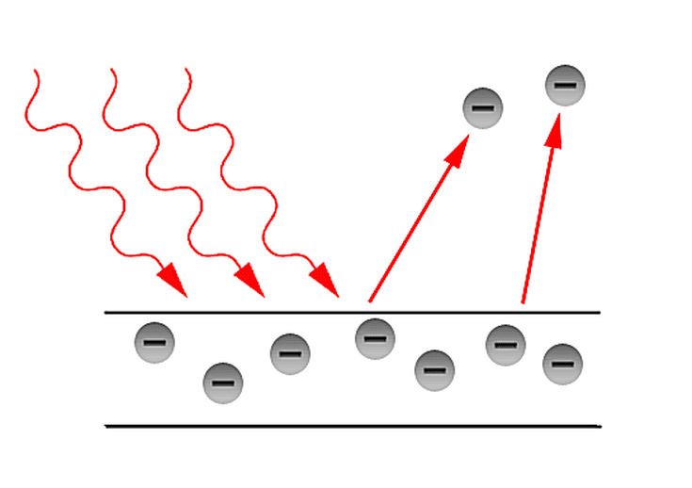


Photoelectric Effect
Is the emission of electrons or other free carriers when light shines on a material.
Formulas:
Where:
h = 6.62621034 J/s or 4.13571015 eV (Planck’s constant)

Slide 3
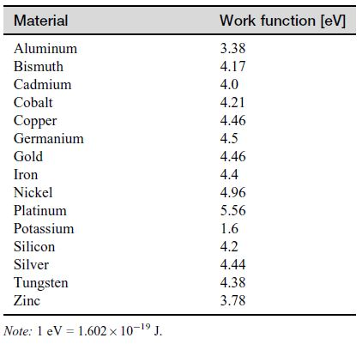
Work Function Table

Slide 4


Sample Problem
Consider a photoelectric device intended for light detection.
Assuming it is made of a potassium-coated surface, what is the lowest wavelength that the device can detect?
C = λf ; C is the speed of light (3x10^8)
b. What is the kinetic energy of an emitted electron under red light radiation at a wavelength of 620 nm?

Slide 5
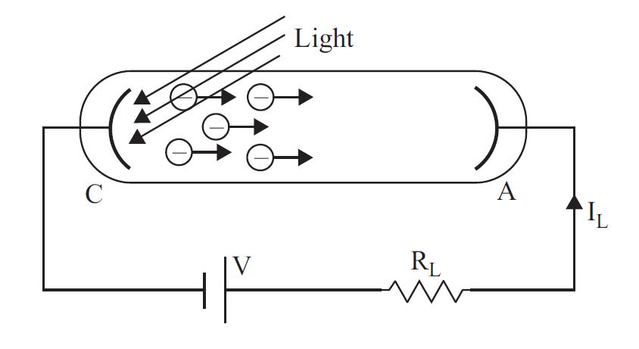
Photoelectric Sensors
How it works?

Slide 6
The photocathode is made of a material with relatively low work function to allow efficient emission of electrons. These electrons are then accelerated toward the photoanode because of the potential difference between the anode and cathode. The current in the circuit is then proportional to radiation intensity.

Slide 7
Photomultipliers

Slide 8


Formula:
Current Gain
; n = the average number of electrons emitted per dynode
k = number of dynodes
Dark Current
a = constant depending on the material of the cathode (generally around 0.5)
A = 120.173 A/cm2
T = absolute temperature
Eo = work function of the cathode material (e.V)
k = Boltzmann’s constant

Slide 9
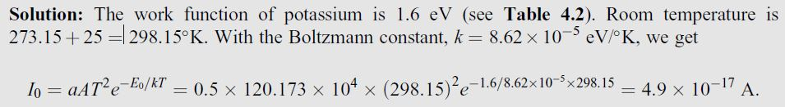
Sample Problem
A photomultiplier with 10 dynodes has a cathode coated with potassium to increase sensitivity. Calculate the thermally produced dark current at the cathode and at the anode at 25C, assuming that each incoming photon is energetic enough to release six electrons and that each accelerated electron releases six electrons.
CATHODE

Slide 10

ANODE
Finding the gain:
Multiply the gain to Io,

Slide 11

Coupled Charge Device (CCD) Sensors

Slide 12
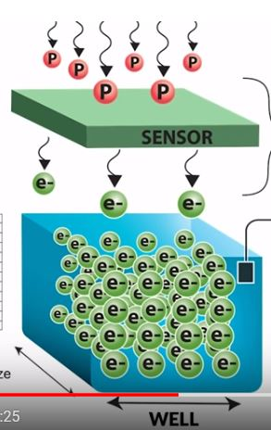

Slide 13
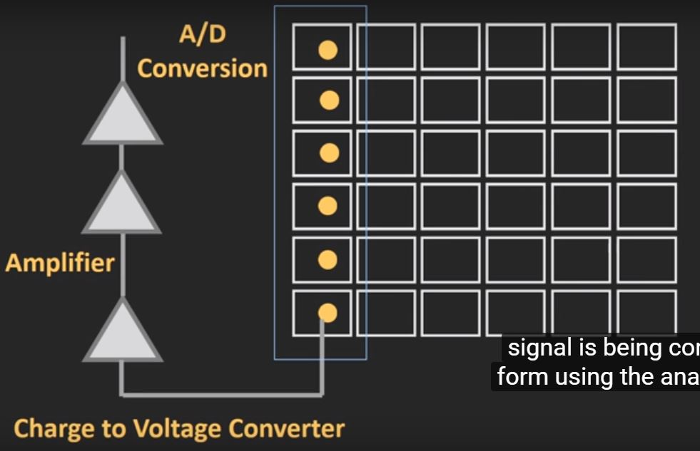

Slide 14
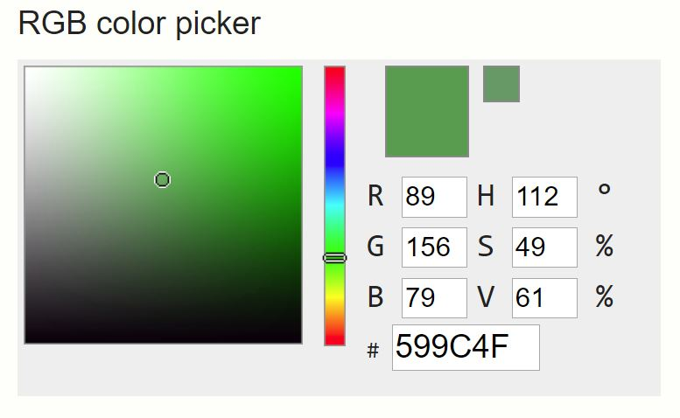

Slide 15
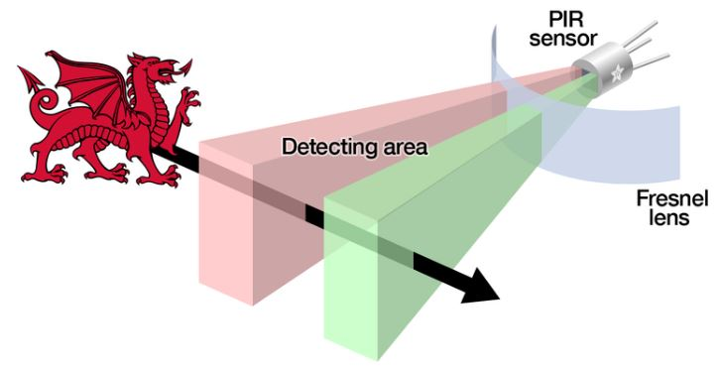
Passive Infrared Sensor
A PIR sensor has two basic components: an absorption section that converts radiation into heat and a proper temperature sensor that converts heat into an electrical signal.

Slide 16
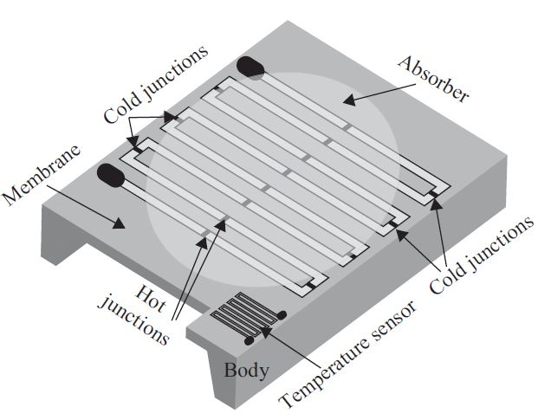
Thermopile PIR

Slide 17

Pyroelectric Sensor
The pyroelectric effect is an electric charge generated in response to heat flow through the body of a crystal.
Formulas:
Charge
A = area of the sensor
Pq = constant depending on the material, see Table 4.4

Slide 18

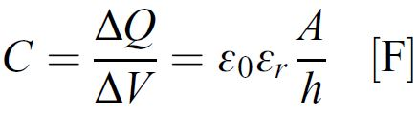
Voltage
Pv = its pyroelectric voltage coefficient, see Table 4.4
h = thickness of the crystal
Capacitance

Slide 19
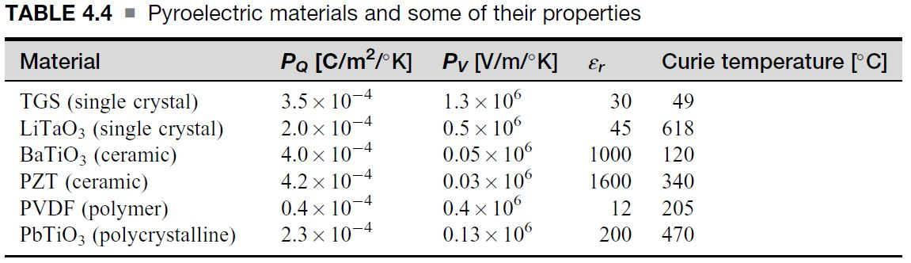
Table 4.4

Slide 20
Sample Problem
A motion sensor based on a PZT ceramic is used to turn on lights in a room as a person enters the room. The sensor is made of two conducting plates with a PZT chip (8 mm wide 10 mm long 0.1 mm thick) between them, forming a capacitor. One plate is exposed to the motion, whereas the other is connected to the body of the sensor and held at its temperature. As the person enters the room, the person’s body temperature causes the exposed plate’s temperature to temporarily rise by 0.01C because of the IR radiation produced by the body. This temperature dissipates and eventually both plates will reach the same steady-state temperature. For this reason the sensor can detect motion but not presence. Calculate the charge produced on the plate and the potential difference across the sensor due to the rise in temperature.

Slide 21
Solution

Slide 22
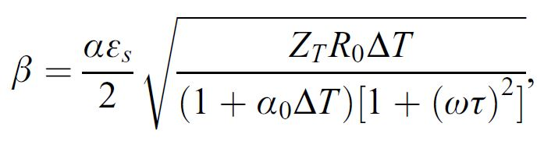
Bolometers
The radiation is absorbed by the device directly, causing a change in its temperature. This temperature increase is proportional to the radiated power density at the location of sensing. This change causes a change in the resistance of the sensing element that is then related to the power or power density at the location being sensed.
The sensitivity of a bolometer to radiation can be written as follows:

Slide 23


Active Far Infrared Sensor
Formulas:
Power supplied to the sensor
P = V^2/R
Φ = the radiation power being sensed
, power loss through the sensor

Slide 24
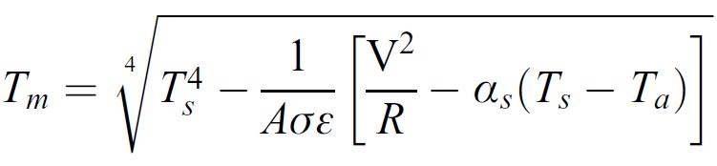
αs = is a loss coefficient or thermal conductivity
Ts = the sensor’s temperature
Ta = the ambient temperature
Sensed Temperature
Where σ is the electric conductivity of the sensor medium

